Slide 1
Tech Clothing Merch app
Nathan Aamodt, Diana Gonzales, Pradeep Raut, Bailey Wessels

Slide 2
Overview
Product Overview
About the App
Code Snippets
App Demo

Slide 3
Products
Selling Product: Clothing Merch
Product Line Main Choices:
T-shirt
Hoodie
Sweatshirt
Accessories Choices:
Sizes – Small, Medium, Large, X-Large
Colors – black, white, red, grey
Design Prints:
“I love coding”
“while”
“binary”

Slide 4
About the app
Device Compatibility: Android Phone (Pixel 4 XL)
Target Customer: Tech People
App Main Parts:
Home
Shop
Cart
Checkout
Features:
Apply Discount - Buy 3 Get 1 FREE
Be able to fill Customer Info - shipping and payment

Slide 5
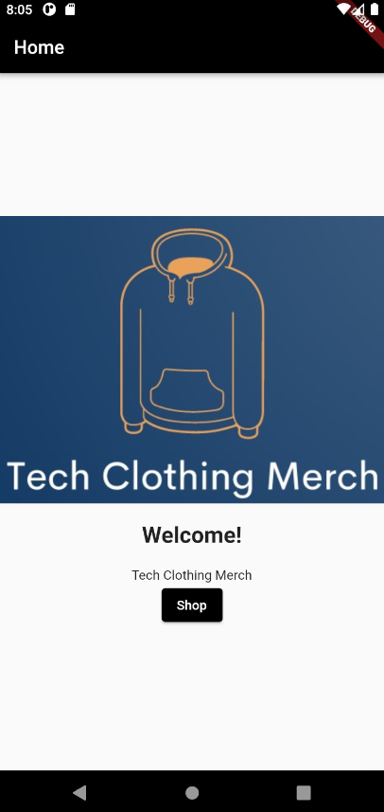
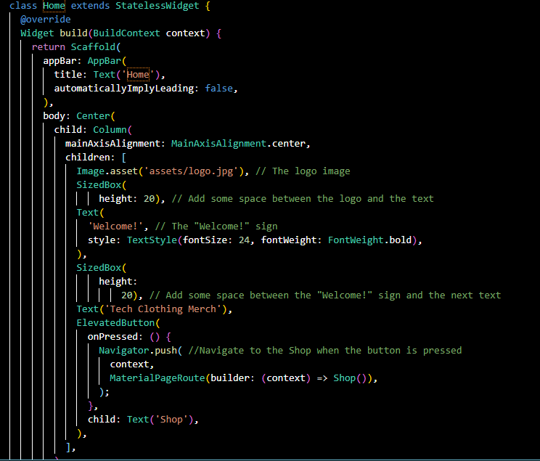
HOME

Slide 6
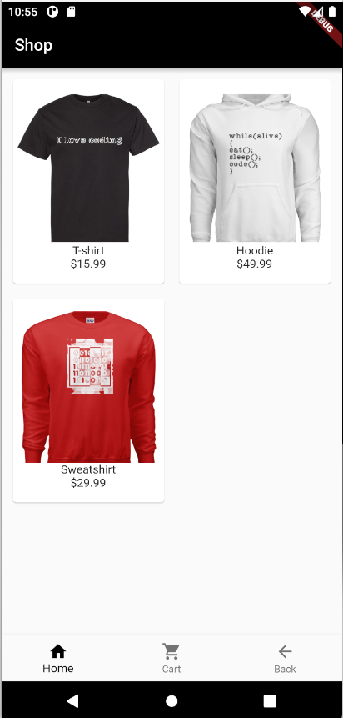
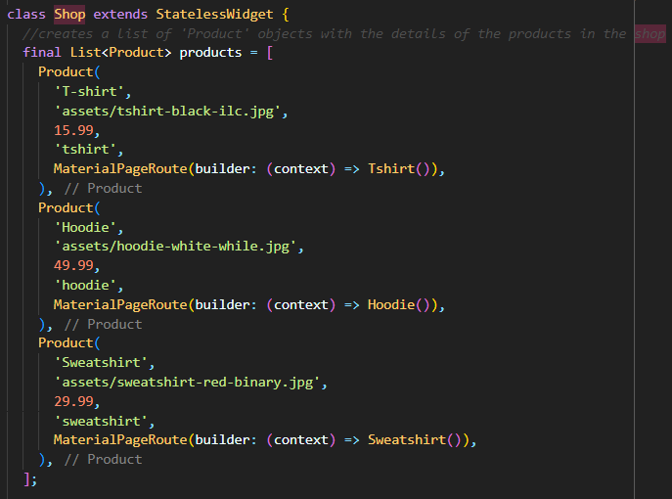
shop
shop.dart

Slide 7
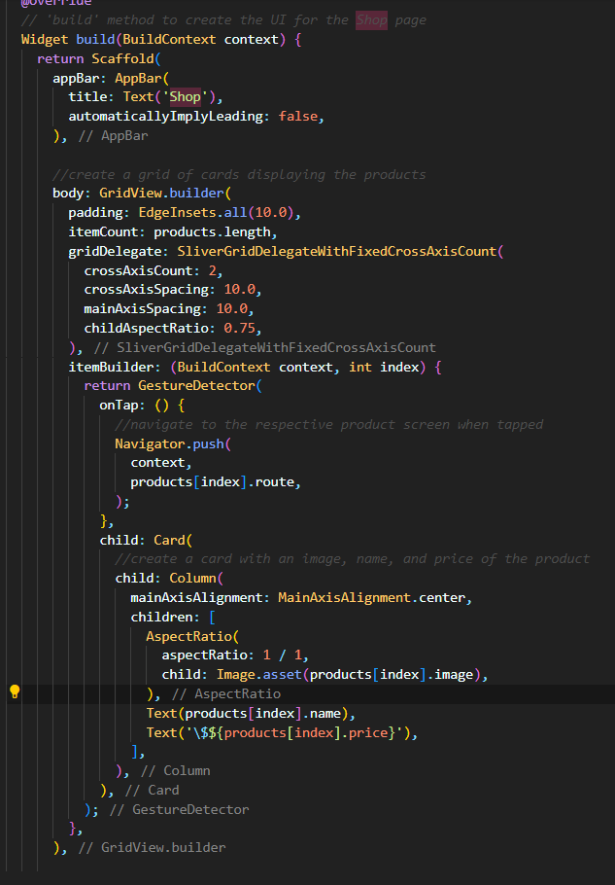
shop
shop.dart

Slide 8
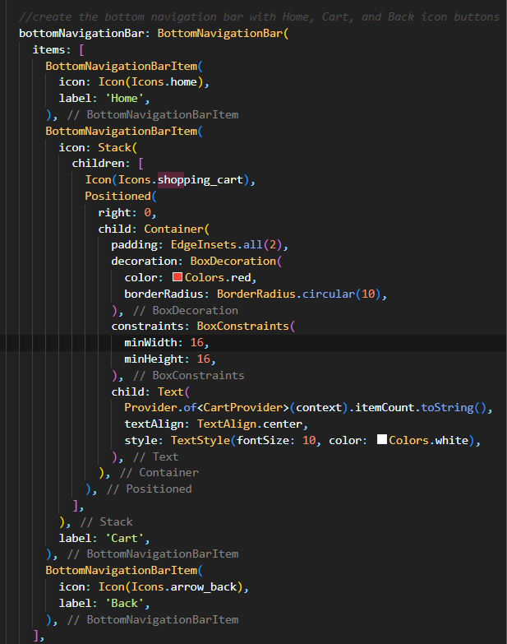
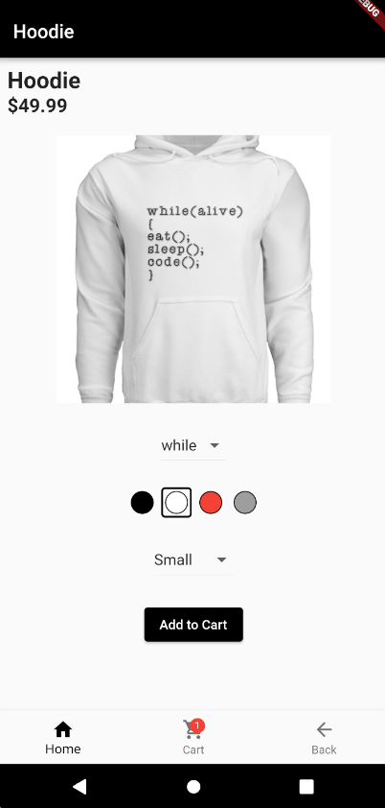
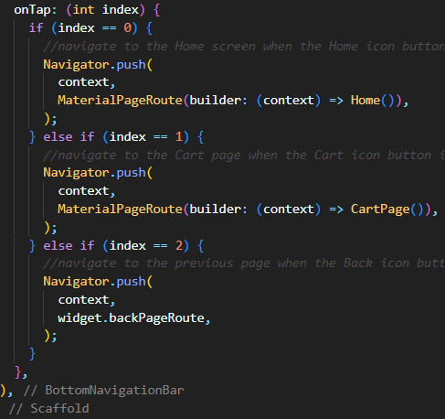
shop
shop.dart

Slide 9
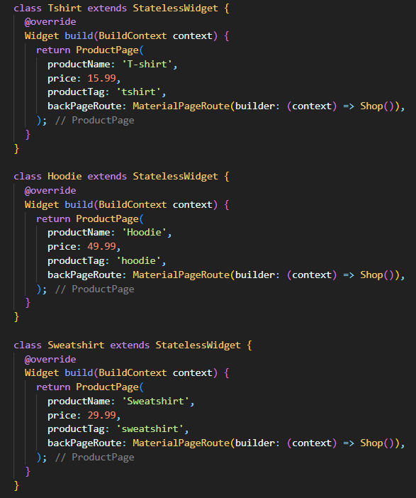
shop
shop.dart

Slide 10
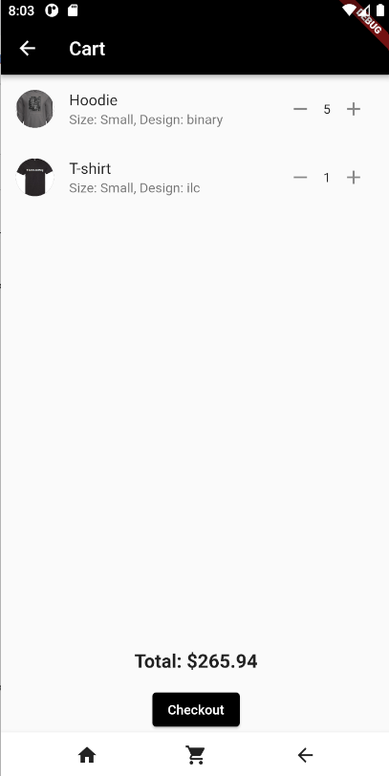
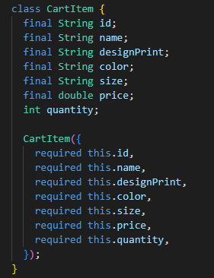
cart
Cart_Item.dart

Slide 11
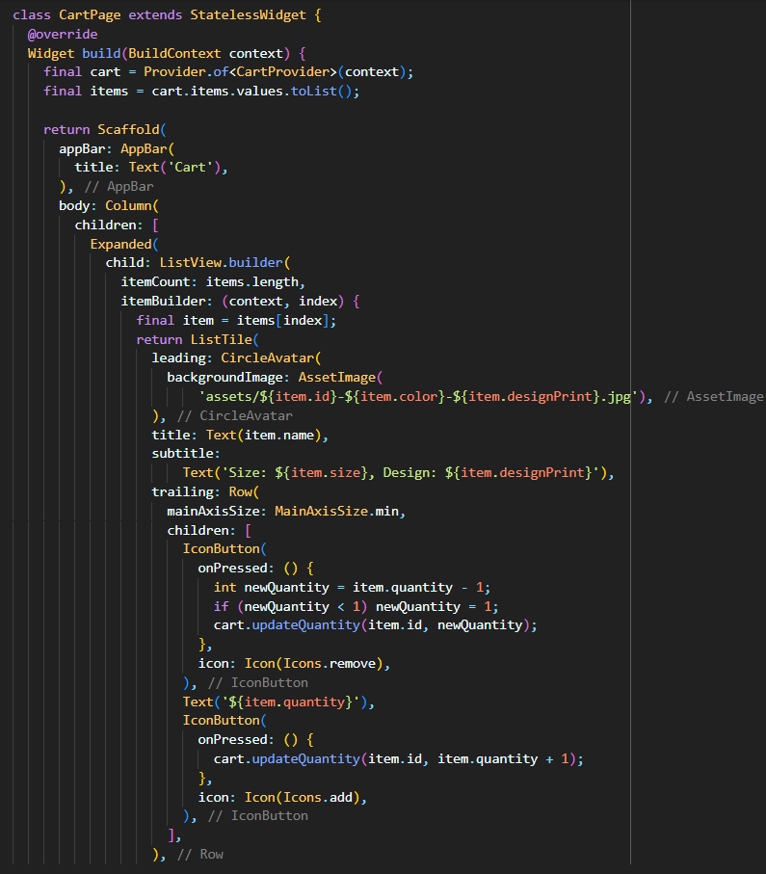
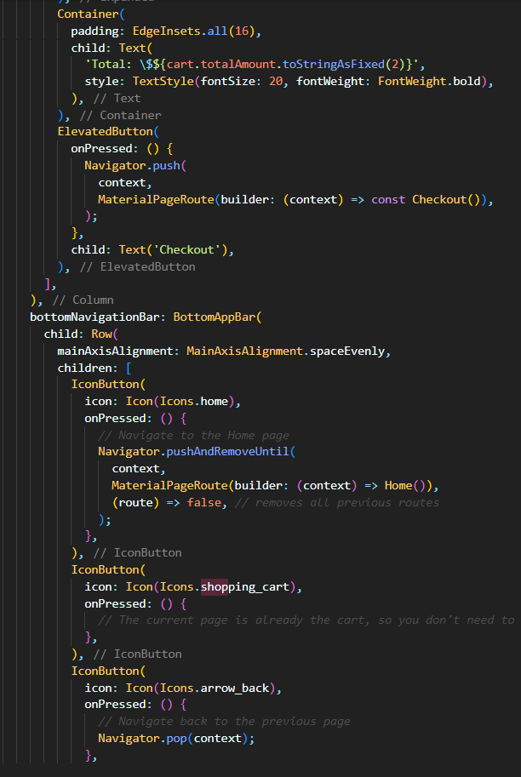
cart

Slide 12
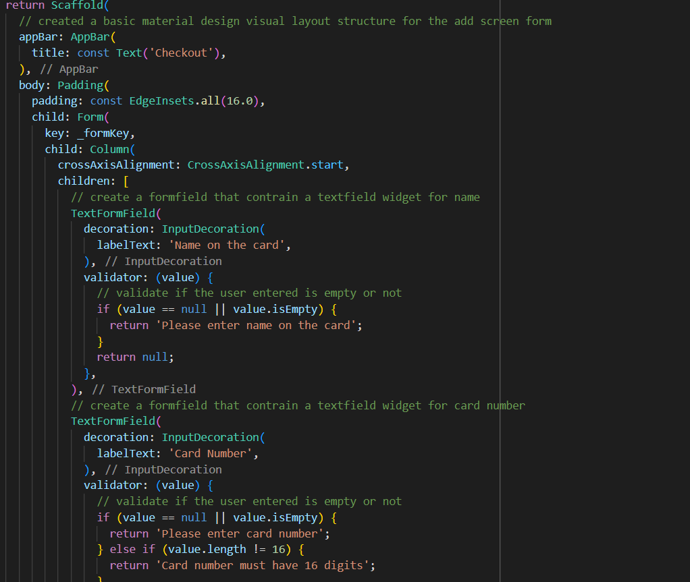
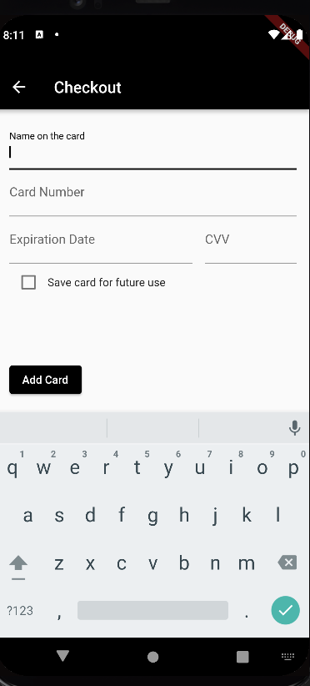
checkout
Use discussed “widgets” (Flutter Widgets Catalog) where appropriate: • Assets, images, icon, ... • Basic • Layout • Material Components • ... • Organization o External/Standalone Models (Classes) and Widgets – user created NOT predefined

Slide 13
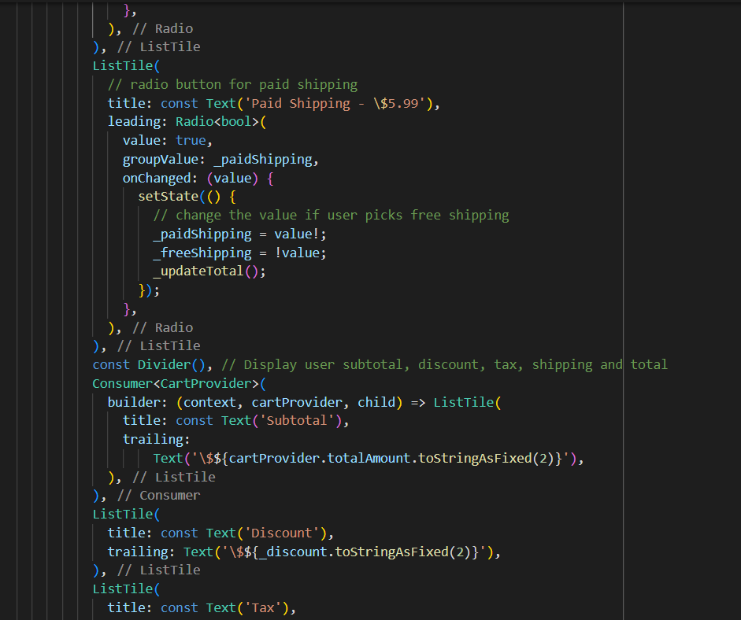
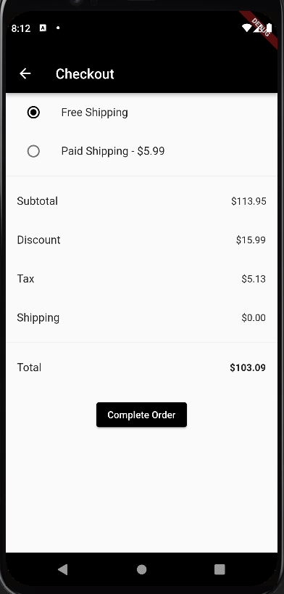
checkout
Use discussed “widgets” (Flutter Widgets Catalog) where appropriate: • Assets, images, icon, ... • Basic • Layout • Material Components • ... • Organization o External/Standalone Models (Classes) and Widgets – user created NOT predefined

Slide 14
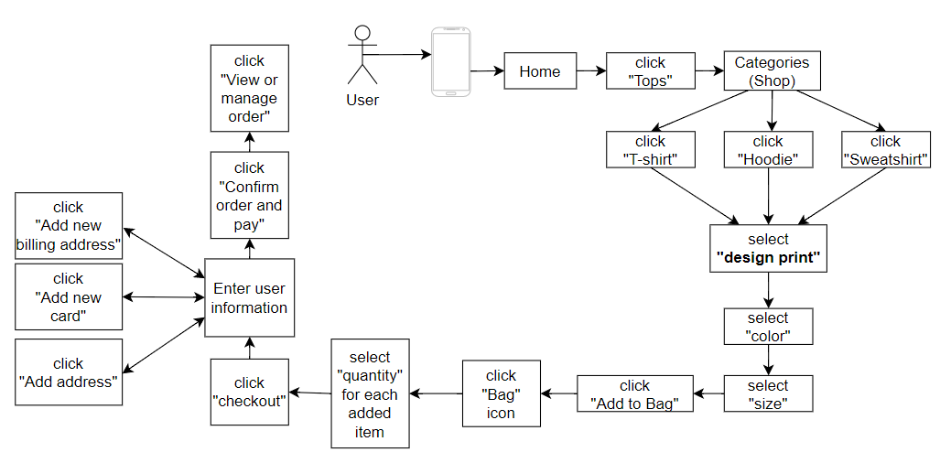
Story Board

Slide 15
APP Demo

Slide 16
Questions?

